Slide 1

Customer Segmentation Analysis
Vijay Kumar

Slide 2
Introduction
Overview:
This dataset captures transactional details from various shopping mall, providing a comprehensive view of customer purchasing
behavior. It includes demographic information, purchase details and payment methods, making it deal for customer segmentation and
behavioral analysis.
Dataset Summary:
Total Records: 1000 transactions
Time Period Covered: Based on invoice dates (e.g., 2021–2023)
Shopping Locations: Multiple malls such as Emaar Square Mall, Mall of Istanbul, and Viaport Outlet.
Key Features:

Slide 3
Introduction
Key Features:
Column Name | Description
invoice_no | Unique transaction ID
customer_id | Unique customer identifier
gender | Gender of the customer (Male/Female)
age | Age of the customer
category | Product category purchased
quantity | Number of items purchased
price | Total price of the transaction
payment_method | Method of payment (Cash, Debit/Credit Card)
invoice_date | Date of transaction
shopping_mall | Name of the shopping mall

Slide 4
Introduction
Purpose of Analysis:
Understand shopping patterns across gender and age groups
Identify top-selling categories and revenue drivers
Explore the relationship between payment methods and other features
Provide actionable business insights and recommendations

Slide 5
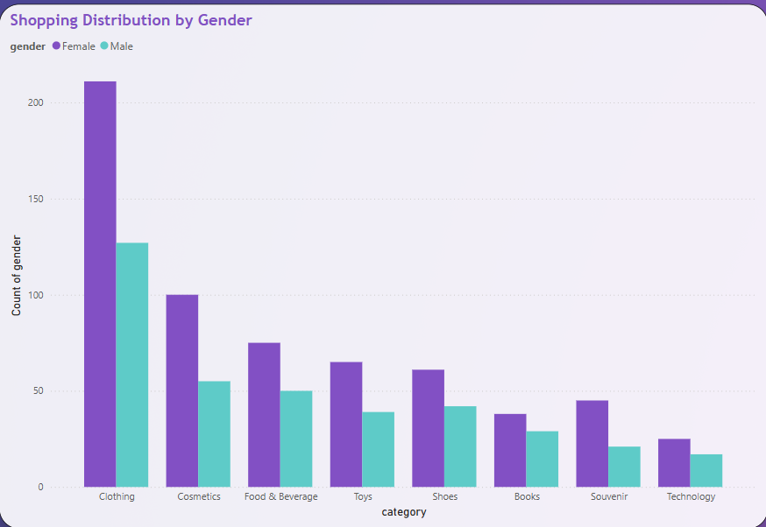
Shopping Distribution by Gender

Slide 6
Shopping Distribution by Gender
Visual Insight:
This bar chart represents the distribution of shopping activities across different product categories segmented by
gender (Female vs Male).
Key Observations:
Clothing is the most popular category overall, with females leading by a significant margin (over 200 purchases vs ~130 by males).
Cosmetics and Food & Beverage also show higher engagement from female shoppers.
In all categories shown, female customers made more purchases than males, indicating a stronger engagement in retail shopping.
Categories like Toys, Shoes, Books, Souvenirs, and Technology also follow this trend, though the difference is less pronounced.

Slide 7
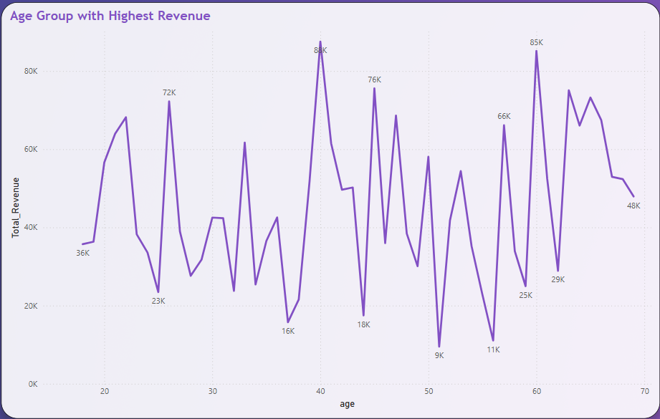
Age Group with Highest Revenue

Slide 8
Age Group with Highest Revenue
Visual Insight:
This line chart illustrates the total revenue generated by customers across various age groups. The trend helps us
identify which age brackets contribute the most to business revenue.
Key Observations:
The highest revenue was generated by customers aged around 60, contributing approximately 85K.
Other high-revenue age groups include:
Age 40 (~80K)
Age 45 (~76K)
Age 25 (~72K)
Age 58 (~66K)
Revenue contributions are spread across all age groups, but the most consistent and highest spikes occur between ages 25 and 60.
There are noticeable dips in revenue in younger (below 20) and older (above 65) age groups.

Slide 9
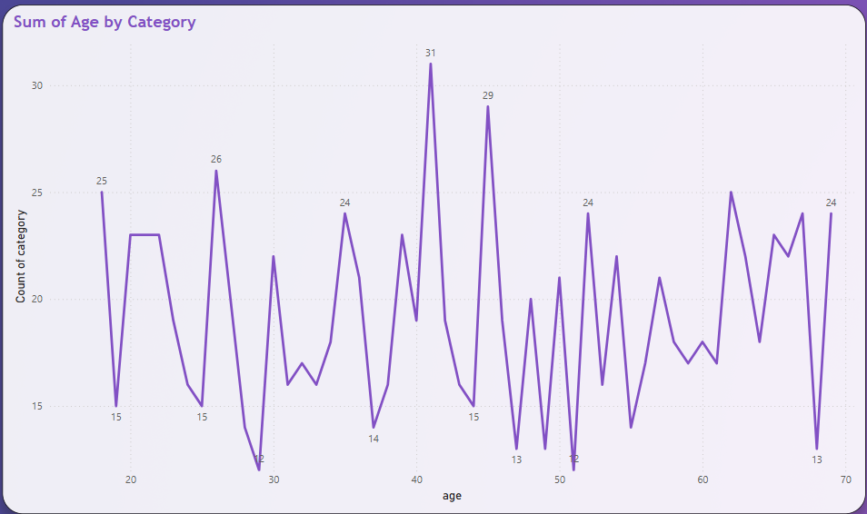
Sum of Age by Category

Slide 10
Sum of Age by Category
Visual Insight:
This line chart represents the number of product categories purchased across different age groups. It helps
identify how actively different age groups engage with a variety of product categories.
Key Observations:
The age group around 41 has the highest category count, indicating diverse shopping interests (31 categories).
Other notable age peaks:
Age 46 (29 categories)
Age 26 and 63 (both around 24–26 categories)
Ages between 35 and 50 show more variation and activity across multiple product categories.
Some fluctuations are seen across all age groups, but mid-age shoppers (30–50) tend to explore more categories than younger or older customers.

Slide 11
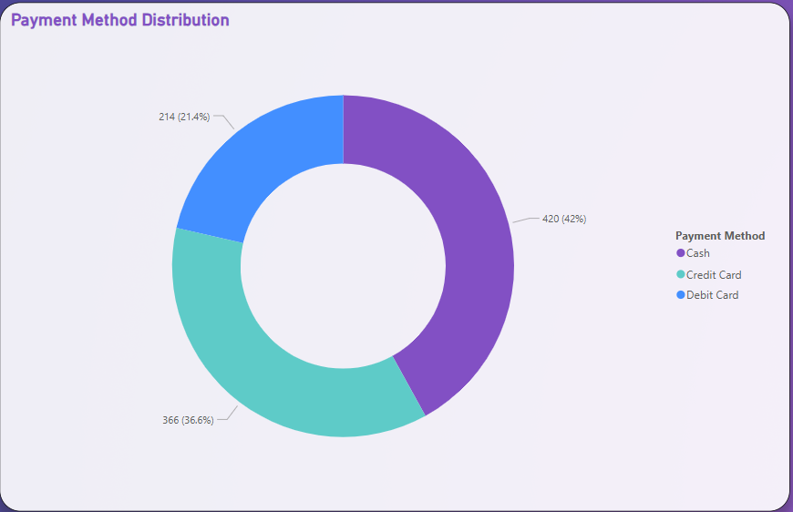
Payment Method Distribution

Slide 12
Payment Method Distribution
Visual Insight:
This donut chart displays the distribution of payment methods used by customers during
their purchases. It highlights which methods are most preferred and can guide financial
planning and customer convenience strategies.
Key Observations:
Cash is the most used payment method, accounting for 42% of transactions (420 purchases).
Credit Cards are the second most common, used in 36.6% of purchases (366 purchases).
Debit Cards are the least used, contributing to only 21.4% of purchases (214 transactions).

Slide 13
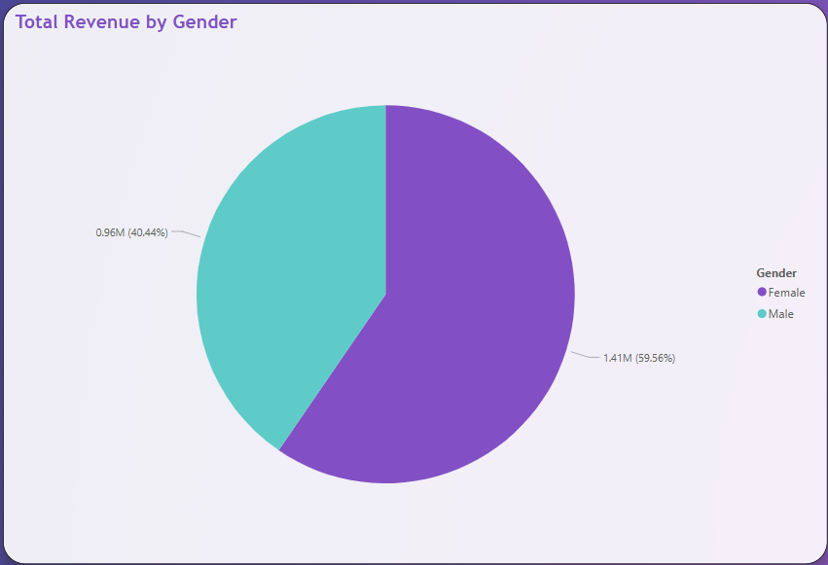
Total Revenue by Gender

Slide 14
Total Revenue by Gender
Visual Insight:
This pie chart showcases the total revenue generated by each gender group. It provides
valuable insights into customer segments contributing the most to overall sales.
Key Observations:
Female customers contributed approximately 1.41 million in revenue, which accounts for 59.56% of the total revenue.
Male customers contributed around 0.96 million, making up 40.44% of the revenue.

Slide 15
Conclusion
1. Gender-Based Trends:
Females dominate both shopping frequency and revenue generation, accounting for 59.56% of the total revenue.
Categories like Clothing, Cosmetics, and Food & Beverage are especially popular among female shoppers.
Male participation is comparatively lower, both in count and spending.
2. Age-Based Behavior:
The age group around 40 and 60 years shows the highest revenue spikes, indicating a strong spending capability.
These age groups are more likely to make larger or more frequent purchases.
Customer interest across age ranges is diverse, but peaks in certain years suggest age-specific marketing could be highly effective.

Slide 16
Conclusion
3. Payment Preferences:
Cash is the most preferred payment method (42%), followed by Credit Cards (36.6%), and Debit Cards (21.4%).
The reliance on cash indicates potential for digital payment adoption campaigns or discounts on cashless transactions.
4. Product Category Insights:
Clothing is the most purchased category, especially among females.
Other top-performing categories include Cosmetics, Food & Beverage, and Toys.
Categories like Technology and Books show lower engagement and could be improved through product bundling or promotions.

Slide 17
Conclusion
Business Recommendations:
Focus marketing efforts on women, especially in the Clothing and Cosmetics categories.
Tailor campaigns for the 40–60 age group, who are key revenue contributors.
Encourage digital payments by offering incentives, especially to users preferring cash.
Use these insights to drive personalized offers, loyalty programs, and inventory decisions.

